Slide 1

Artificial Intelligence
Constraint Satisfaction Problems
CS 444 – Spring 2021
Dr. Kevin Molloy
Department of Computer Science
James Madison University
Much of this lecture is taken from
Dan Klein and Pieter Abbeel AI class at UC Berkeley

Slide 2
Learning Objectives for Today
Assumptions about the world: a single agent, deterministic actions, fully observed state, discrete state space
Planning: sequences of actions
The path to the goal is the important thing
Paths have various costs, depths
Heuristics give problem-specific guidance
Identification: assignments to variables
The goal itself is important, not the path
All paths at the same depth (for some formulations)
CSPs are specialized for identification problems
Figure from Berkley AI

Slide 3


Constraint Satisfaction Problems
Standard search problems:
State is a “black box”: arbitrary data structure
Goal test can be any function over states
Successor function can also be anything
Constraint satisfaction problems (CSPs):
A special subset of search problems
State is defined by variables X_{i} with values from a domain D (sometimes D depends on i)
Goal test is a set of constraints specifying allowable combinations of values for subsets of variables
Allows useful general-purpose algorithms with more power than standard search algorithms
Figure from Berkley AI

Slide 4
Example CSP: Map Coloring
Figure from Berkley AI

Slide 5


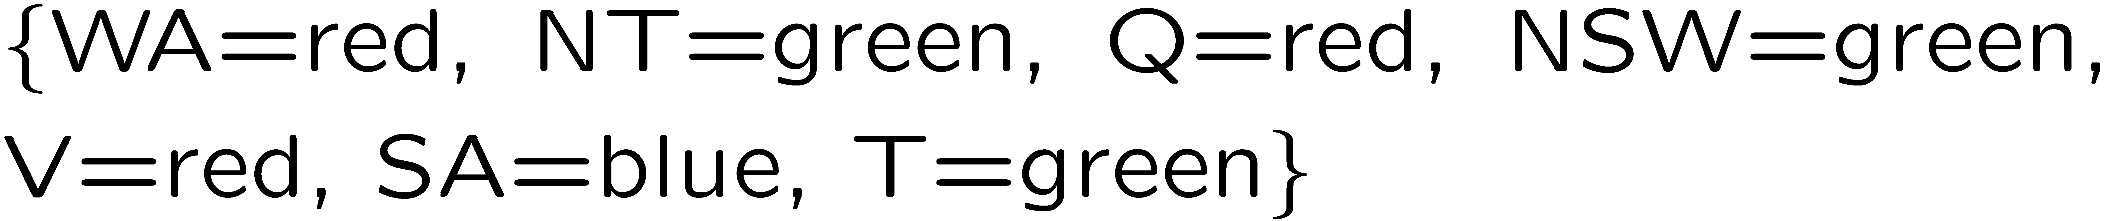
Example CSP: Map Coloring Problem Formulation
Variables:
Domains:
Constraints: adjacent regions must have different colors
Solutions are assignments satisfying all constraints, e.g.:
Implicit:
Explicit:
Figure from Berkley AI

Slide 6
Example CSP: Map Coloring Search Problem
States:
Successor function:
Start state:
Goal State
Partial assignment (or full assignment) of variables.
Make an assignment to an unassigned variable.
All variables unassigned (no countries colored).
All variables assigned and no constraints violated
Figure from Berkley AI

Slide 7
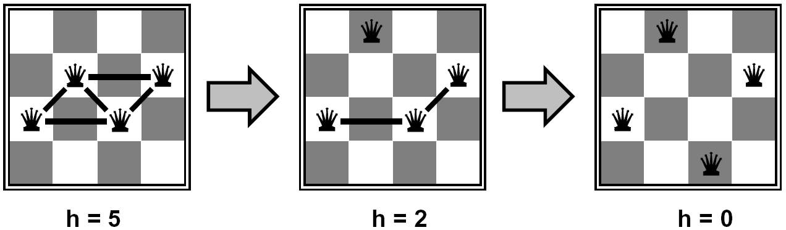

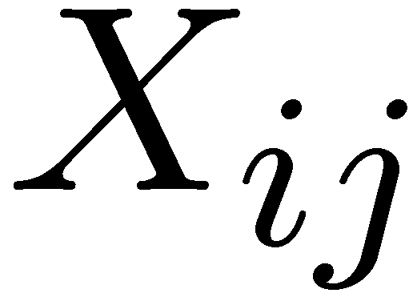

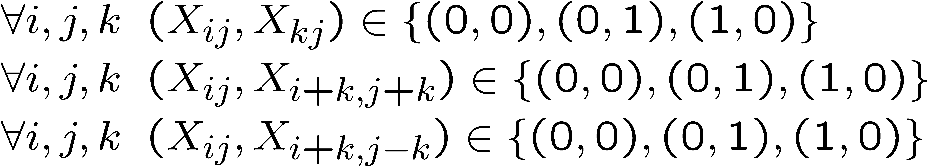
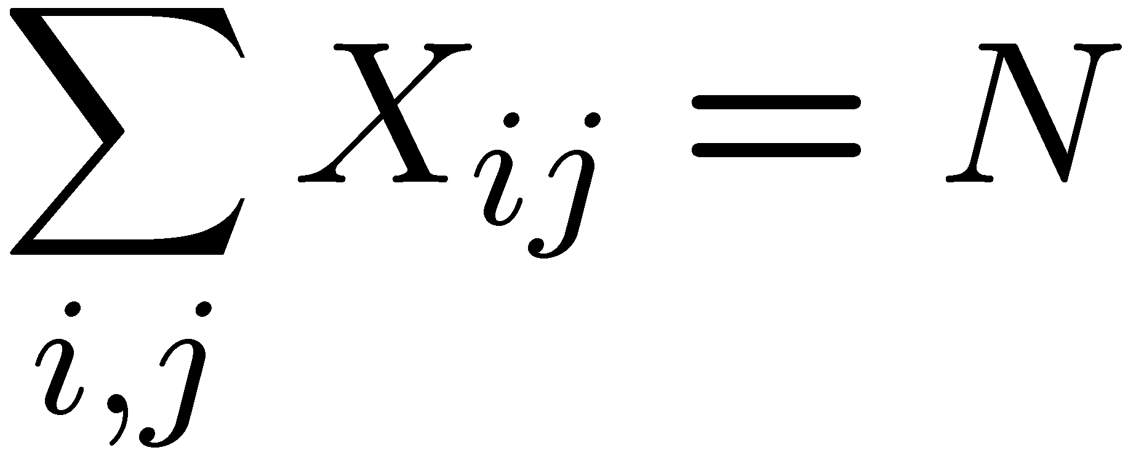
Example CSP: N-Queens
Formulation 1:
Variables:
Domains:
Constraints
Figure from Berkley AI

Slide 8

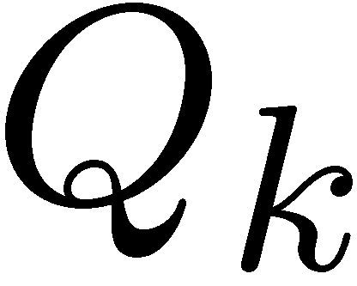





Example CSP: N-Queens
Formulation 2:
Variables:
Domains:
Constraints:
Implicit:
Explicit:
Figure from Berkley AI

Slide 9
Constraint Graphs
Figure from Berkley AI

Slide 10
Constraint Graphs
Binary CSP: each constraint relates (at most) two variables
Binary constraint graph: nodes are variables, arcs show constraints
General-purpose CSP algorithms use the graph structure to speed up search. E.g., Tasmania is an independent subproblem!
Figure from Berkley AI

Slide 11


Example: Cryptarithmetic
Variables:
Domains:
Constraints:
Figure from Berkley AI

Slide 12
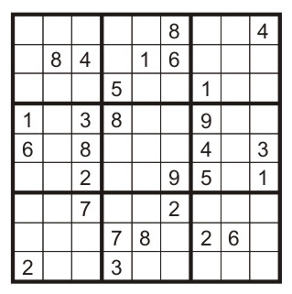
Example: Sudoku
Variables:
Each (open) square
Domains:
{1,2,…,9}
Constraints:
9-way alldiff for each column
9-way alldiff for each row
9-way alldiff for each region
(or can have a bunch of pairwise inequality constraints)
Figure from Berkley AI

Slide 13


Varieties of CSPs
Discrete Variables
Finite domains
Size d means O(d^{n}) complete assignments
E.g., Boolean CSPs, including Boolean satisfiability (NP-complete)
Infinite domains (integers, strings, etc.)
E.g., job scheduling, variables are start/end times for each job
Linear constraints solvable, nonlinear undecidable
Continuous variables
E.g., start/end times for Hubble Telescope observations
Linear constraints solvable in polynomial time by LP methods (see cs170 for a bit of this theory)
Figure from Berkley AI

Slide 14



Varieties of Constraints
Varieties of Constraints
Unary constraints involve a single variable (equivalent to reducing domains), e.g.:
Binary constraints involve pairs of variables, e.g.:
Higher-order constraints involve 3 or more variables:
e.g., cryptarithmetic column constraints
Preferences (soft constraints):
E.g., red is better than green
Often representable by a cost for each variable assignment
Gives constrained optimization problems
(We’ll ignore these until we get to Bayes’ nets)
Figure from Berkley AI

Slide 15
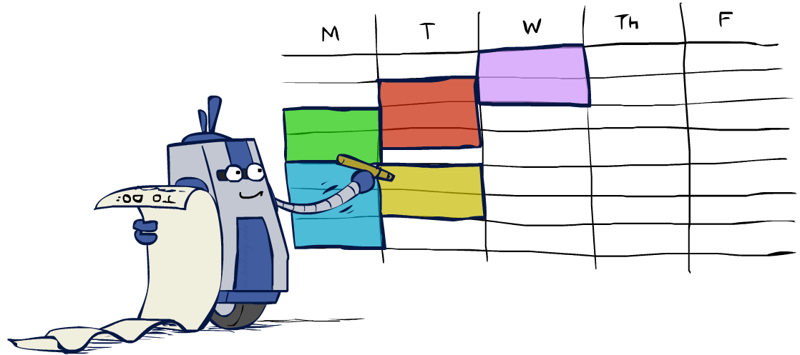
Real-World CSPs
Assignment problems: e.g., who teaches what class
Timetabling problems: e.g., which class is offered when and where?
Hardware configuration
Transportation scheduling
Factory scheduling
Circuit layout
Fault diagnosis
… lots more!
Many real-world problems involve real-valued variables…
Figure from Berkley AI

Slide 16
Solving a CSP: Standard Search Formulation
Standard search formulation of CSPs
States defined by the values assigned so far (partial assignments)
Initial state: the empty assignment, {}
Successor function: assign a value to an unassigned variable
Goal test: the current assignment is complete and satisfies all constraints
We’ll start with the straightforward, naïve approach, then improve it
Figure from Berkley AI

Slide 17
Search Methods
What would BFS do?
What would DFS do?
What problems does naïve search have?
https://inst.eecs.berkeley.edu/~cs188/fa19/assets/demos/csp/csp_demos.html
Figure from Berkley AI
Notes:
Demo:
CS188 javascript demos -> source -> exercises -> csps -> CSPs demos -> CSPs demos.html
Settings:
Graph = Simple
Algorithm = Naïve Search
Ordering = None
Filtering = None

Slide 18

Backtracking Search
Backtracking search is the basic uninformed algorithm for solving CSPs
Idea 1: One variable at a time
Variable assignments are commutative, so fix ordering
I.e., [WA = red then NT = green] same as [NT = green then WA = red]
Only need to consider assignments to a single variable at each step
Idea 2: Check constraints as you go
I.e. consider only values which do not conflict previous assignments
Might have to do some computation to check the constraints
“Incremental goal test”
Depth-first search with these two improvements
is called backtracking search (not the best name)
Can solve n-queens for n ≈ 25
Figure from Berkley AI

Slide 19
Backtracking Example
Figure from Berkley AI

Slide 20
Backtracking Search
Backtracking = DFS + variable-ordering + fail-on-violation
What are the choice points?
Figure from Berkley AI

Slide 21

Improving Backtracking
General-purpose ideas give huge gains in speed
Ordering:
Which variable should be assigned next?
In what order should its values be tried?
Filtering: Can we detect inevitable failure early?
Structure: Can we exploit the problem structure?
Figure from Berkley AI

Slide 22
Filtering: Forward Checking
Filtering: Keep track of domains for unassigned variables and cross off bad options
Forward checking: Cross off values that violate a constraint when added to the existing assignment
WA
NT
Q
SA
NSW
V
[Demo: coloring -- forward checking]
Figure from Berkley AI
Notes:
Demo:
CS188 javascript demos -> source -> exercises -> csps -> CSPs demos -> CSPs demos.html
Settings:
Graph = Simple
Algorithm = Backtracking
Ordering = None
Filtering = Forward Checking

Slide 23
Filtering: Constraint Propagation
Forward checking propagates information from assigned to unassigned variables, but doesn't provide early detection for all failures:
NT and SA cannot both be blue!
Why didn’t we detect this yet?
Constraint propagation: reason from constraint to constraint
NT
Q
WA
SA
NSW
V
Figure from Berkley AI

Slide 24

Consistency of a Single Arc
An arc X → Y is consistent iff for every x in the tail there is some y in the head which could be assigned without violating a constraint
Forward checking: Enforcing consistency of arcs pointing to each new assignment
NT
Q
WA
SA
NSW
V
Delete from the tail!
Figure from Berkley AI

Slide 25
Arc Consistency of an Entire CSP
A simple form of propagation makes sure all arcs are consistent:
Important: If X loses a value, neighbors of X need to be rechecked!
Arc consistency detects failure earlier than forward checking
Can be run as a preprocessor or after each assignment
What’s the downside of enforcing arc consistency?
NT
Q
WA
SA
NSW
V
Remember: Delete from the tail!
Figure from Berkley AI

Slide 26
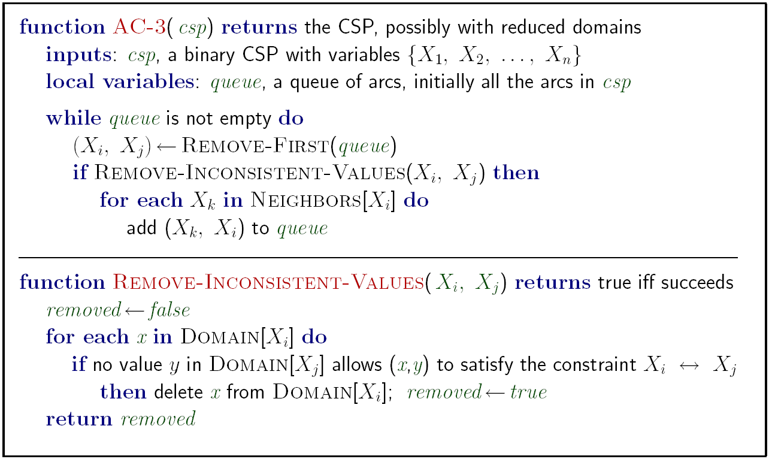
Enforcing Arc Consistency in a CSP
Runtime: O(n²d³), can be reduced to O(n²d²)
… but detecting all possible future problems is NP-hard – why?
[Demo: CSP applet (made available by aispace.org) -- n-queens]
Figure from Berkley AI

Slide 27
Limitations of Arc Consistency
After enforcing arc consistency:
Can have one solution left
Can have multiple solutions left
Can have no solutions left (and not know it)
Arc consistency still runs inside a backtracking search!
What went wrong here?
[Demo: coloring -- forward checking]
[Demo: coloring -- arc consistency]
Figure from Berkley AI

Slide 28

Ordering: Minimum Remaining Values
Variable Ordering: Minimum remaining values (MRV):
Choose the variable with the fewest legal left values in its domain
Why min rather than max?
Also called “most constrained variable”
“Fail-fast” ordering
Figure from Berkley AI

Slide 29

Ordering: Least Constraining Value
Value Ordering: Least Constraining Value
Given a choice of variable, choose the least constraining value
I.e., the one that rules out the fewest values in the remaining variables
Note that it may take some computation to determine this! (E.g., rerunning filtering)
Why least rather than most?
Combining these ordering ideas makes
1000 queens feasible
Figure from Berkley AI
Notes:
Demo:
CS188 javascript demos -> source -> exercises -> csps -> CSPs demos -> CSPs demos.html
Settings:
Graph = Complex
Algorithm = Backtracking
Ordering = MRV

Slide 30
Constraint Graphs
Figure from Berkley AI

